Slide 1

Gated Recurrent Unit (GRU)
Cho, et al. 2014

Slide 2
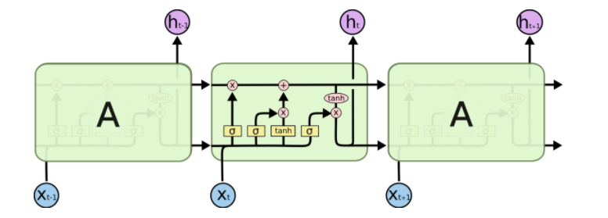
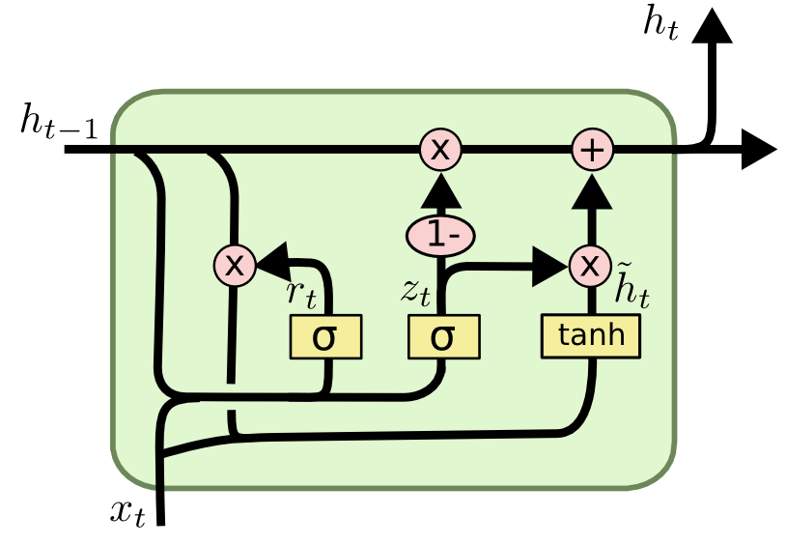
LSTM Cell
GRU Cell
LSTM vs GRU

Slide 3
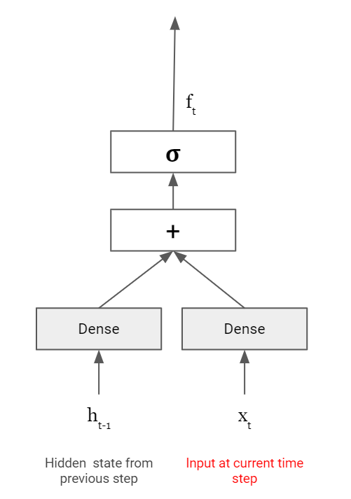
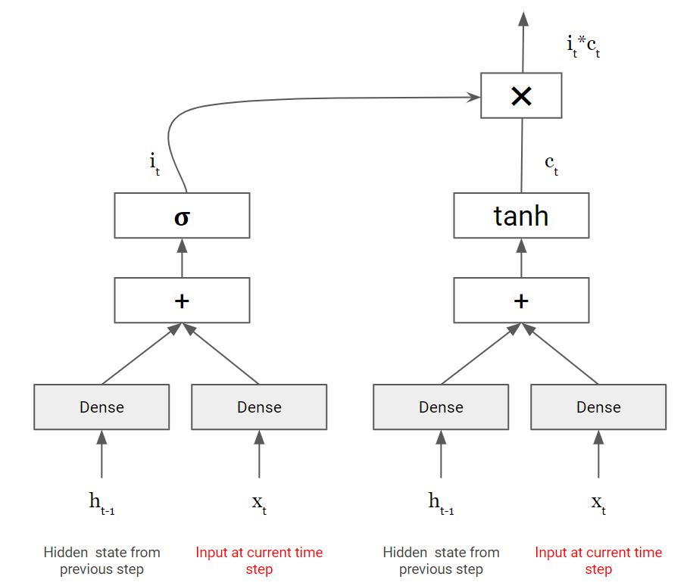
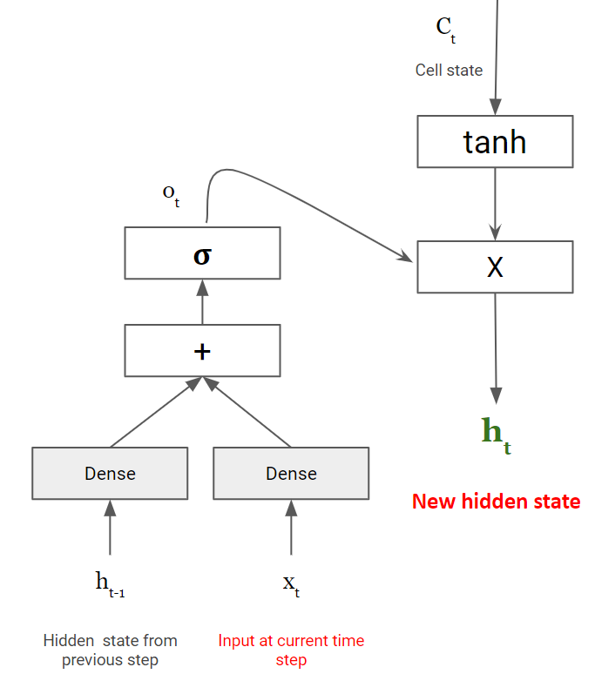
LSTM Cell
Only few things will get added/updated
C_{t-1}
✖
+
Cell state after previous step
List of things to remember and forget
List of things to add/update
Forget Gate
Controls things to remember and forget from memory
Input Gate
Controls what to add / update to memory
Output Gate
Controls what to read from memory

Slide 4
LSTM updates long term memory (Cell state) by
Building list of things to forget and remember (Forget gate)
Build list of things we want to add (candidate cell state)
Decide on which items from 2nd list will move to long term memory (Input gate)
Read Cell state to prepare hidden state (Output Gate)
GRU …
Also does the same thing but with slight modification
Let’s understand how GRU builds it’s memory

Slide 5
Let’s review different GRU components...

Slide 6
Long term memory
h_{t-1}
Hidden state after previous step
GRU uses only one memory … Hidden state

Slide 7

How to delete (or forget) and remember things using GRU?

Slide 8
[3,1,4,0,-5]
Long term memory
[1.5, 1.0, 0, 0, -5.0]
h_{t-1}
✖
Hidden state after previous step
List of things to remember and forget
Values between 0 and 1
[0.5, 1.0, 0, 0.1, 1.0]
z_{t}
𝛔
Just like LSTM ...
+
Dense
Dense
h_{t-1}
x_{t}
Hidden state from previous step
Input at current time step

Slide 9

How to Add/Update things in GRU memory?

Slide 10
Decides what will be added to memory from add/update list
[3,1,4,0,-5]
Long term memory
[2.5, 1.0, 0, 1.2, -5.0]
[1.5, 1.0, 0, 0, -5.0]
h_{t-1}
✖
+
Hidden state after previous step
(1-z_{t})*c_{t}
[1.0, 0, 0, 1.2, 0]
1- Z_{t}
✖
[0.5, 1.0, 0, 0.1, 1.0]
z_{t}
[0.5, 0, 1, 0.9, 0]
𝛔
c_{t}
[2, 1, 0, 1.3, 1]
GRU
Update Gate
Responsible for both removing and adding information to memory
+
list of things to add/update
Dense
Dense
h_{t-1}
x_{t}
Candidate Hidden state
Hidden state from previous step
Input at current time step

Slide 11

How do we prepare Add/Update list?

Slide 12
Long term memory
h_{t-1}
✖
+
What items from long term memory will considered to build add/update list
Hidden state after previous step
(1-z_{t})*c_{t}
1- Z_{t}
✖
r_{t}
z_{t}
c_{t}
(Candidate Hidden state)
𝛔
𝛔
+
+
A filtered version of long term memory is used to build add/update list
Forget any short term dependencies
Dense
Dense
Dense
Dense
h_{t-1}
x_{t}
h_{t-1}
x_{t}
Hidden state from previous step
Input at current time step
Hidden state from previous step
Input at current time step

Slide 13
Long term memory
h_{t-1}
✖
+
Hidden state after previous step
GRU
Reset Gate
(1-z_{t})*c_{t}
1- Z_{t}
✖
r_{t}
z_{t}
c_{t}
(Candidate Hidden state)
𝛔
𝛔
+
+
Dense
Dense
Dense
Dense
h_{t-1}
x_{t}
h_{t-1}
x_{t}
Hidden state from previous step
Input at current time step
Hidden state from previous step
Input at current time step

Slide 14
GRU Cell
[3,1,4,0,-5]
Long term memory
[1.5, 1.0, 0, 0, -5.0]
[2.5, 1.0, 0, 1.2, -5.0]
h_{t-1}
✖
+
Hidden state after previous step
(1-z_{t})*c_{t}
[1.0, 0, 0, 1.2, 0]
1- Z_{t}
✖
[0.5, 0.9, 0, 0.5, 1.0]
r_{t}
[0.5, 1.0, 0, 0.1, 1.0]
[0.5, 0, 1, 0.9, 0]
[2, 1, 0, 1.3, 1]
z_{t}
c_{t}
(Candidate Hidden state)
𝛔
𝛔
Relu
+
+
+
Dense
Dense
Dense
Dense
Dense
Dense
[1.5, 0.9, 0, 0.5, -5.0]
✖
h_{t-1}
x_{t}
h_{t-1}
x_{t}
x_{t}
Hidden state from previous step
Input at current time step
Hidden state from previous step
Input at current time step
[3,1,4,0,-5]
h_{t-1}
r_{t}
[0.5, 0.9, 0, 0.5, 1.0]

Slide 15
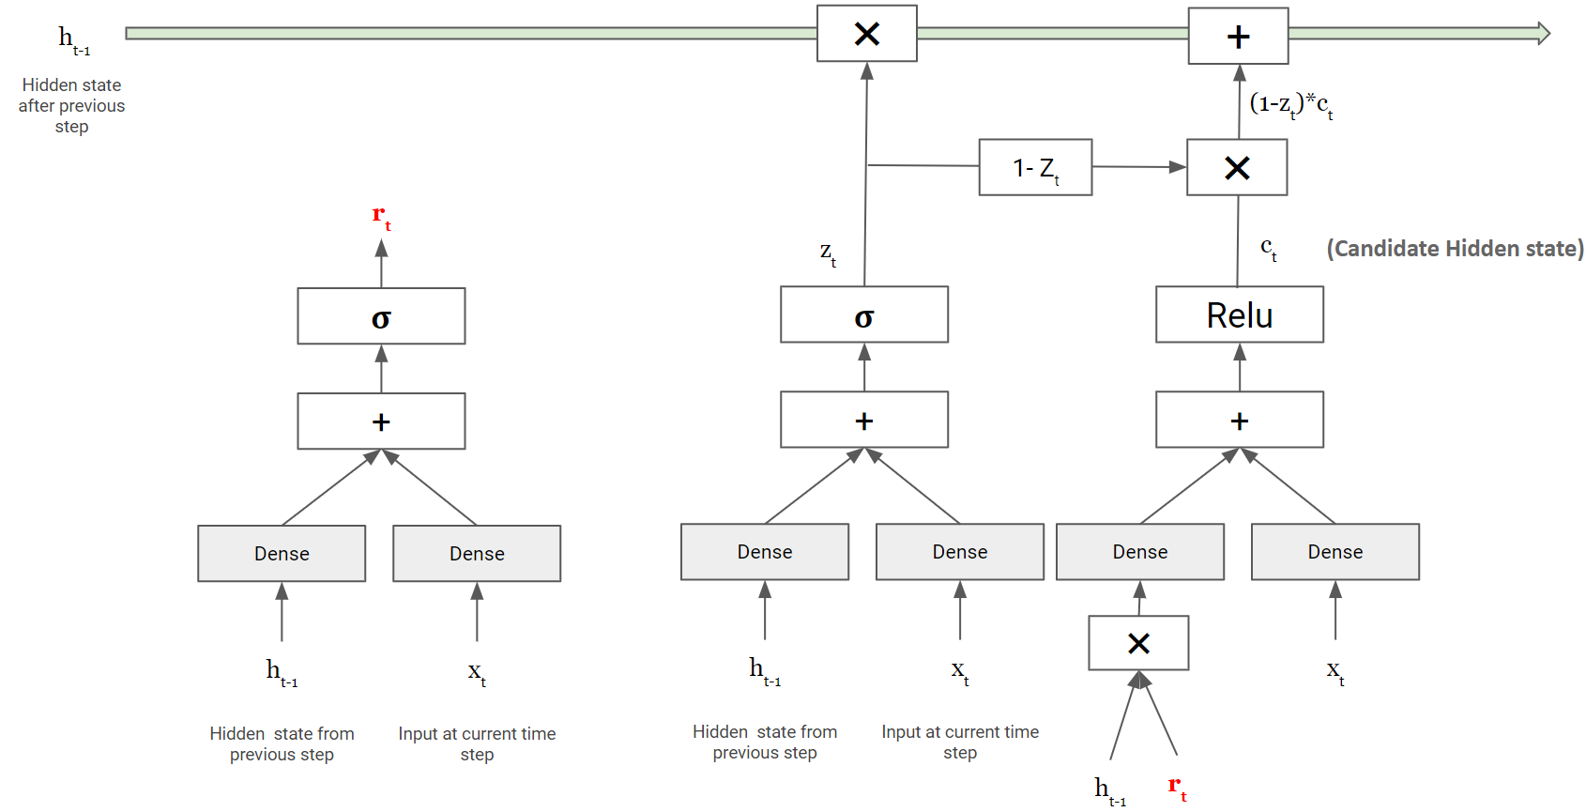
GRU Cell
h_{t}
Reset Gate
Controls what things to use from long term memory to build add/update list
Update Gate
Controls what things to forget and add/update to memory

Slide 16
LSTM vs GRU
Comparison Item | LSTM | GRU
Number of memory/states | 2 (Cell & Hidden State) | 1 (Hidden State)
Number of Gates | 3 (Forget, Input, Output) | 2 (Update, Reset)
Local Memory | Candidate Cell State | Candidate Hidden State
Long term Memory | Cell State | Hidden State
Number of Dense Layers | 8 | 6

Slide 17
Using GRU in Keras
model.add(tf.keras.layers.GRU(256))

